Slide 1


Titolo presentazione sottotitolo
Networked Control: Project 22
Control of an array of masses
Milano, XX mese 20XX
February 2025, Milan
Alfio Locatelli 10645427
Edoardo Airoldi 10697801
Michele Pederzoli 10632981
Carlo Leidi 10621539

Slide 2
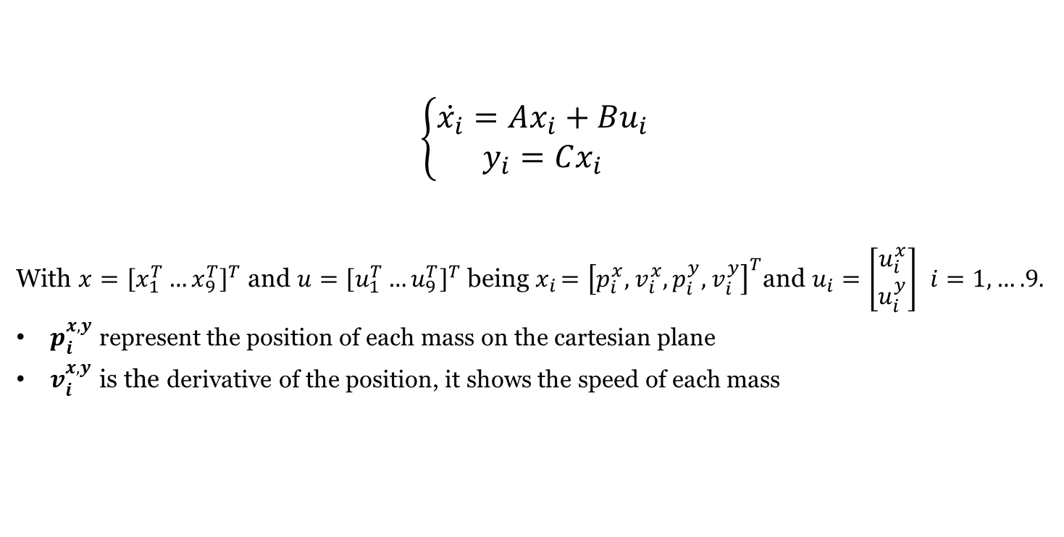
Network Control: Project 22
System Model
$$\left\{\begin{matrix}\dot{x_{i}}=Ax_{i}+Bu_{i} \\ y_{i}=Cx_{i}\end{matrix}\right.$$
With $x={\left[x_{1}^{T}…x_{9}^{T}\right]}^{T}$ and $u={\left[u_{1}^{T}…u_{9}^{T}\right]}^{T}$ being${ x}_{i }={\left[p_{i}^{x},v_{i}^{x},p_{i}^{y},v_{i}^{y}\right]}^{T}$and $u_{i}=\left[\begin{matrix}u_{i}^{x} \\ u_{i}^{y}\end{matrix}\right]$ $i=1,….9.$
$p_{i}^{x,y}$ represent the position of each mass on the cartesian plane
$v_{i}^{x,y}$ is the derivative of the position, it shows the speed of each mass

Slide 3
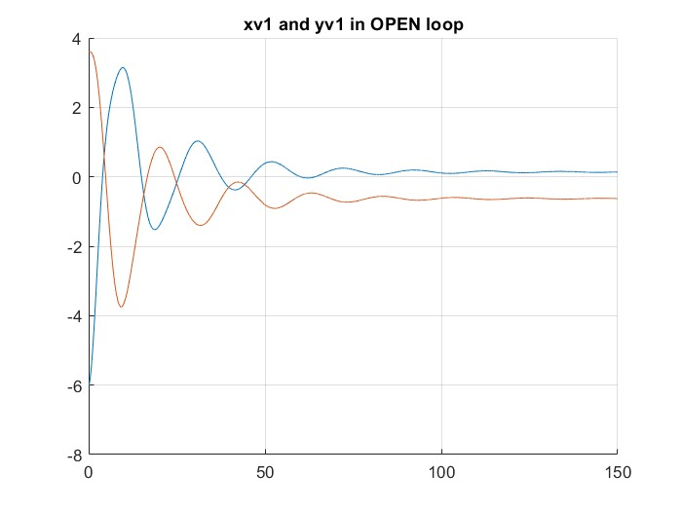
Network Control: Project 22
Eigenvalues and Spectral abscissa
Continous time
Discrete time
-0.2596 + 1.0588i
-0.2596 - 1.0588i
-0.2596 + 1.0588i
-0.2596 - 1.0588i
-0.1449 + 0.7041i
-0.1449 - 0.7041i
-0.2898 + 0.9033i
-0.2898 - 0.9033i
-0.2898 + 0.9033i
-0.2898 - 0.9033i
-0.1449 + 0.7041i
-0.1449 - 0.7041i
-0.1582 + 0.5280i
-0.1582 - 0.5280i
-0.1582 + 0.5280i
-0.1582 - 0.5280i
-0.1346 + 0.5072i
-0.1346 - 0.5072i
-0.1346 + 0.5072i
-0.1346 - 0.5072i
-0.1351 + 0.4072i
-0.1351 - 0.4072i
-0.1351 + 0.4072i
-0.1351 - 0.4072i
-0.0349 + 0.2993i
-0.0349 - 0.2993i
-0.0349 + 0.2993i
-0.0349 - 0.2993i
-0.0513 + 0.2685i
-0.0513 - 0.2685i
-0.0513 + 0.2685i
-0.0513 - 0.2685i
0.0000 + 0.0000i
0.0000 - 0.0000i
0.0000 + 0.0000i
0.0000 + 0.0000i
0.9689 + 0.1030i
0.9689 - 0.1030i
0.9689 + 0.1030i
0.9689 - 0.1030i
0.9832 + 0.0693i
0.9832 - 0.0693i
0.9675 + 0.0876i
0.9675 - 0.0876i
0.9675 + 0.0876i
0.9675 - 0.0876i
0.9832 + 0.0693i
0.9832 - 0.0693i
0.9829 + 0.0519i
0.9829 - 0.0519i
0.9829 + 0.0519i
0.9829 - 0.0519i
0.9854 + 0.0500i
0.9854 - 0.0500i
0.9854 + 0.0500i
0.9854 - 0.0500i
0.9858 + 0.0402i
0.9858 - 0.0402i
0.9858 + 0.0402i
0.9858 - 0.0402i
0.9961 + 0.0298i
0.9961 - 0.0298i
0.9961 + 0.0298i
0.9961 - 0.0298i
0.9945 + 0.0267i
0.9945 - 0.0267i
0.9945 + 0.0267i
0.9945 - 0.0267i
1.0000 + 0.0000i
1.0000 + 0.0000i
1.0000 + 0.0000i
1.0000 + 0.0000i
Simply stable eigenvalues

Slide 4
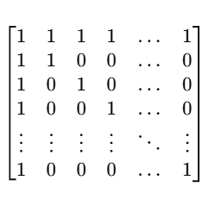
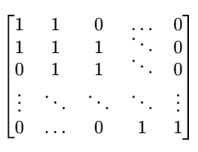
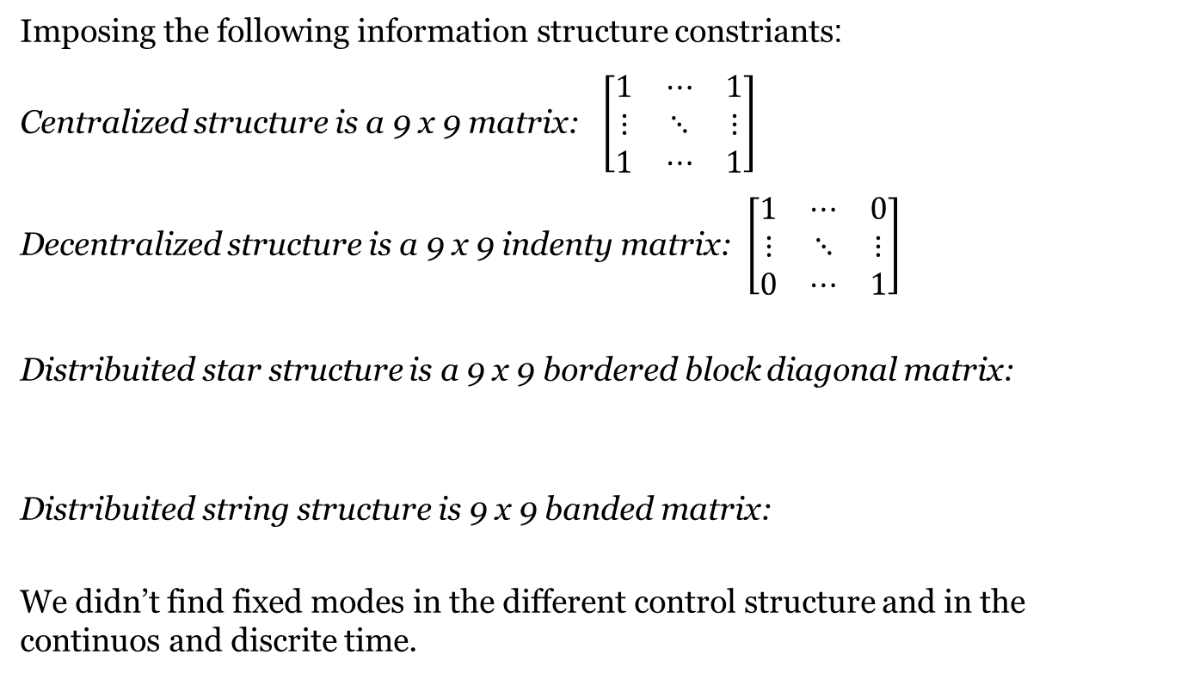
Network Control: Project 22
Structure contraints
Imposing the following information structure constriants:
Centralized structure is a 9 x 9 matrix: $\left[\begin{matrix}1 & ⋯ & 1 \\ ⋮ & ⋱ & ⋮ \\ 1 & ⋯ & 1\end{matrix}\right]$
Decentralized structure is a 9 x 9 indenty matrix: $\left[\begin{matrix}1 & ⋯ & 0 \\ ⋮ & ⋱ & ⋮ \\ 0 & ⋯ & 1\end{matrix}\right]$
Distribuited star structure is a 9 x 9 bordered block diagonal matrix:
Distribuited string structure is 9 x 9 banded matrix:
We didn’t find fixed modes in the different control structure and in the continuos and discrite time.

Slide 5
Network Control: Project 22
Continous time
CONTINUOS TIME

Slide 6
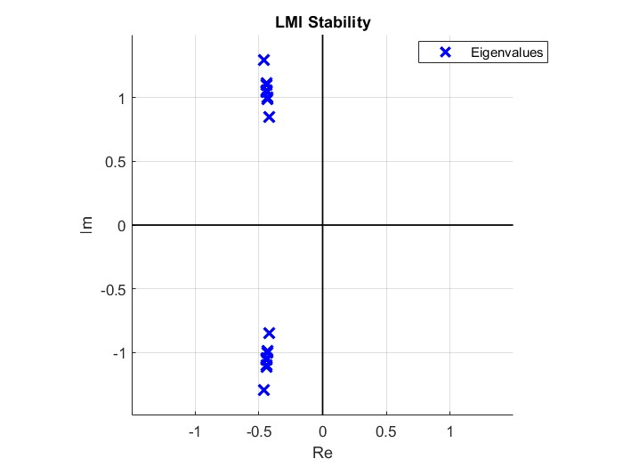
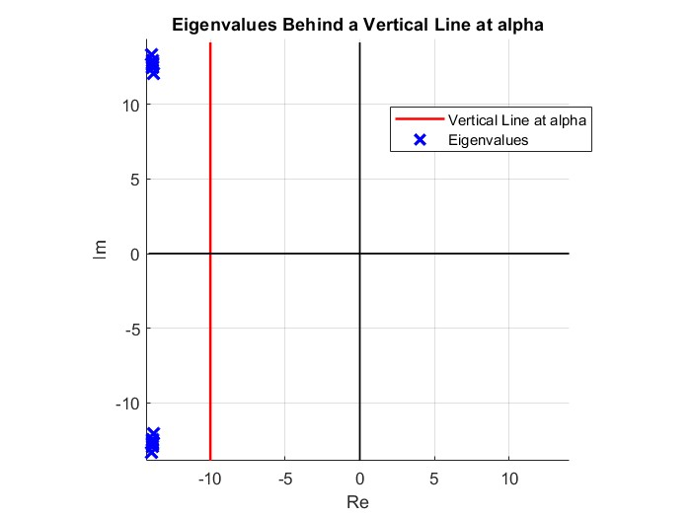
Network Control: Project 22
Continuos time – Cetralized stability and performance control
Spectral abscissa
Spectral abscissa
α= -10

Slide 7
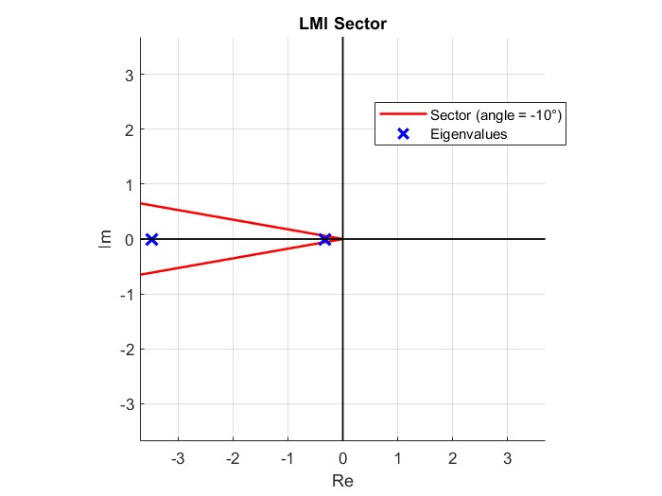
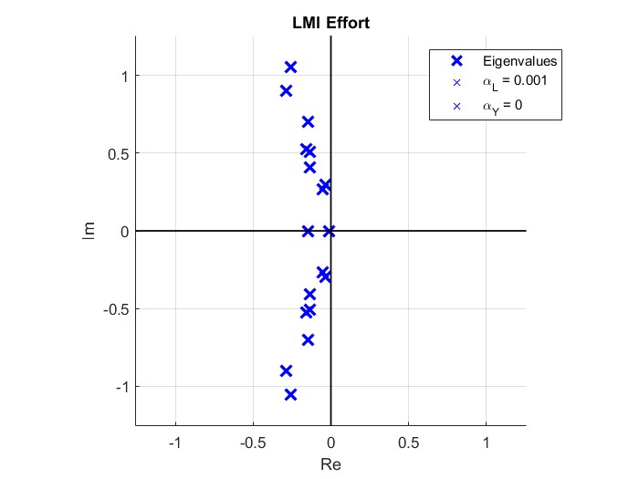
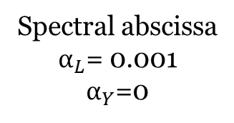
Network Control: Project 22
Continuous time – Centralized sector and effort control
Spectral abscissa
Angle= -10°
Spectral abscissa
$α_{L}$= 0.001
$α_{Y}$=0

Slide 8
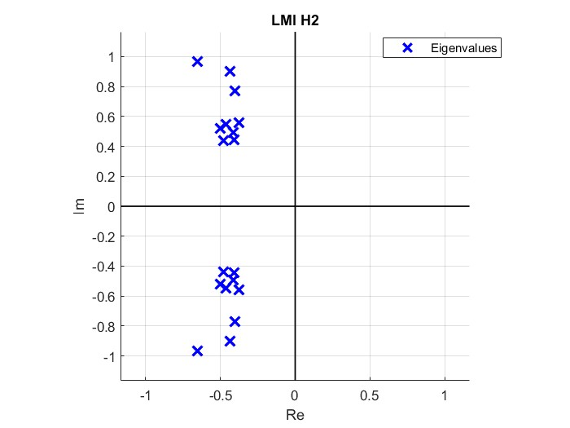
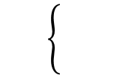
Network Control: Project 22
Continuous time – Centralized H2 control
Spectral abscissa
Angle= -10°

Slide 9
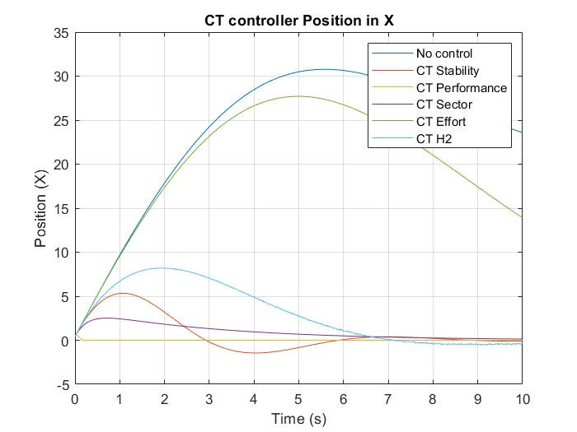
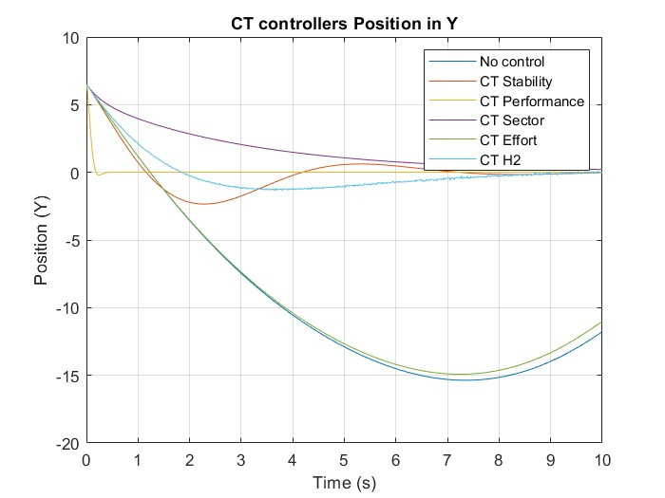
Network Control: Project 22
Continuous time – Position of mass 1 with centralized structure

Slide 10
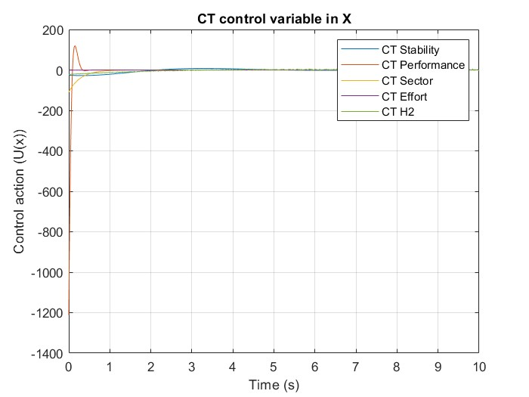
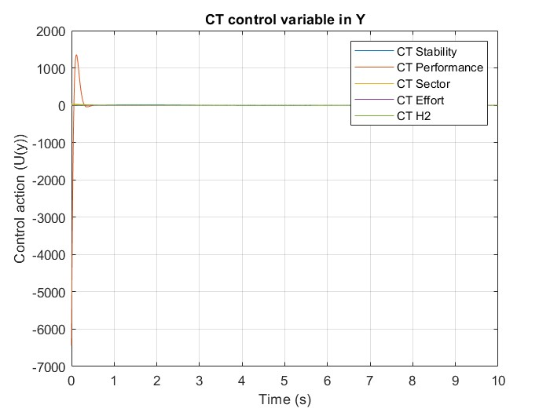
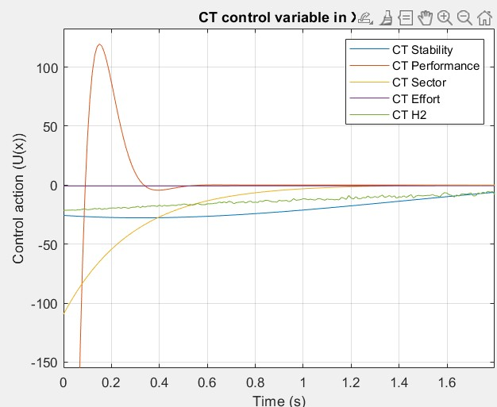
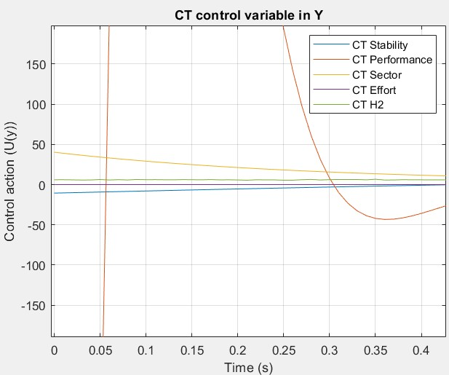
Network Control: Project 22
Continuous time – Centralized control variables

Slide 11
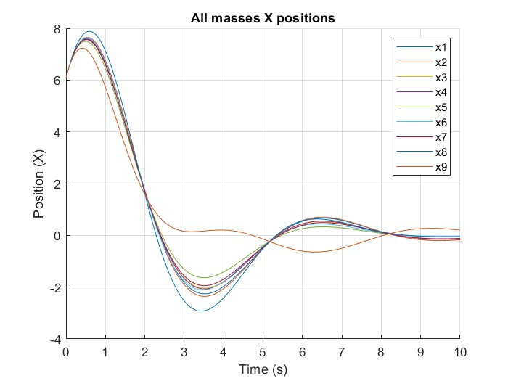
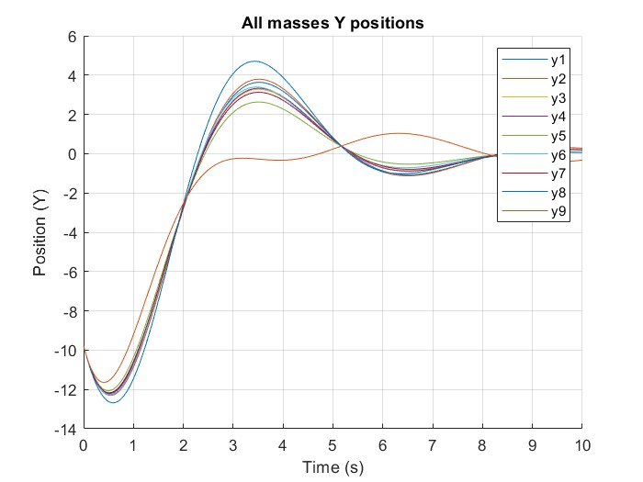
Network Control: Project 22
Continuous time with noise – Centraliced masses posistions same start position
The full output is asymptotically stable

Slide 12
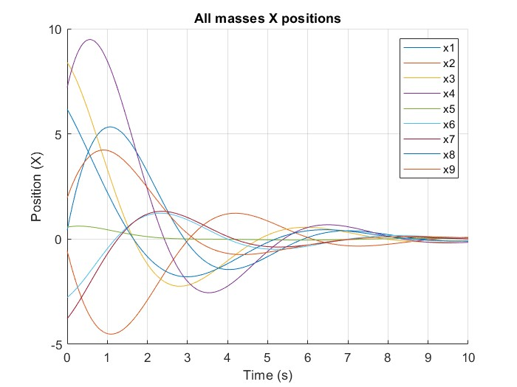
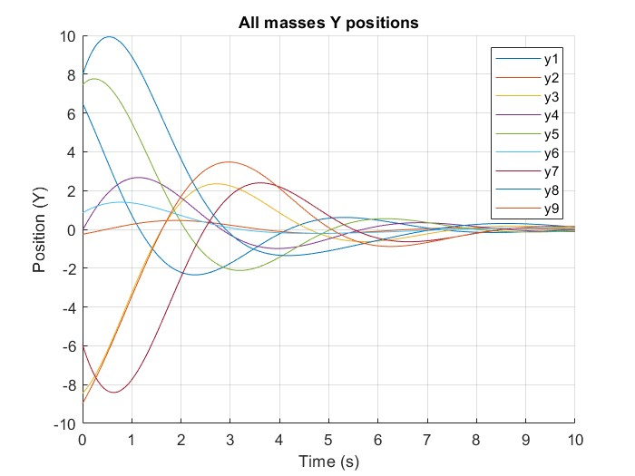
Network Control: Project 22
Continuous time with noise – Centraliced masses posistions
The full output is asymptotically stable

Slide 13
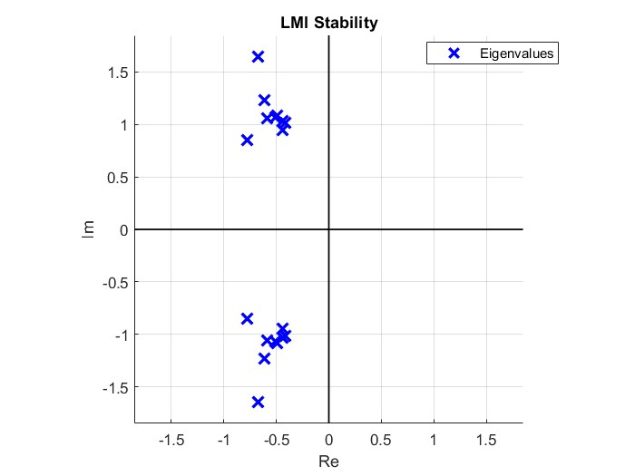
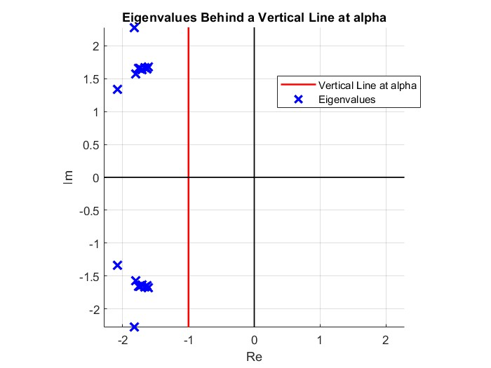
Network Control: Project 22
Continuous time – Decentralized stability and performance control

Slide 14
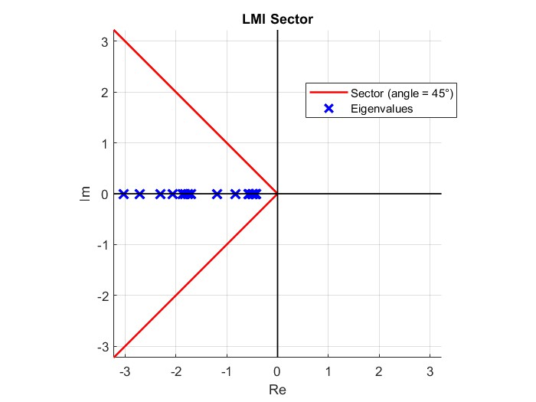
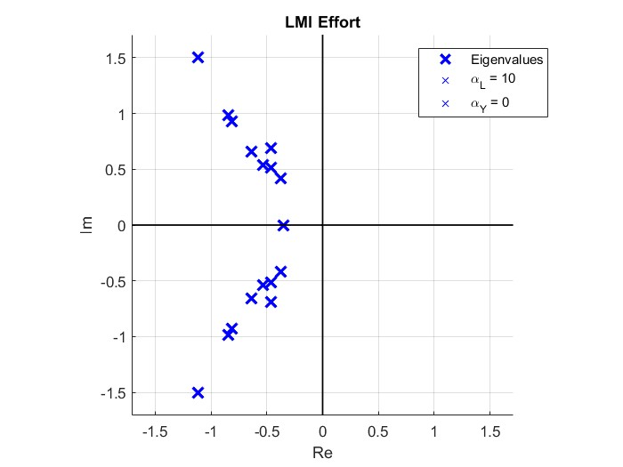
Network Control: Project 22
Continuous time – Decentralized sector and effort control

Slide 15
Network Control: Project 22
Continuous time – Decentralized H2 control

Slide 16
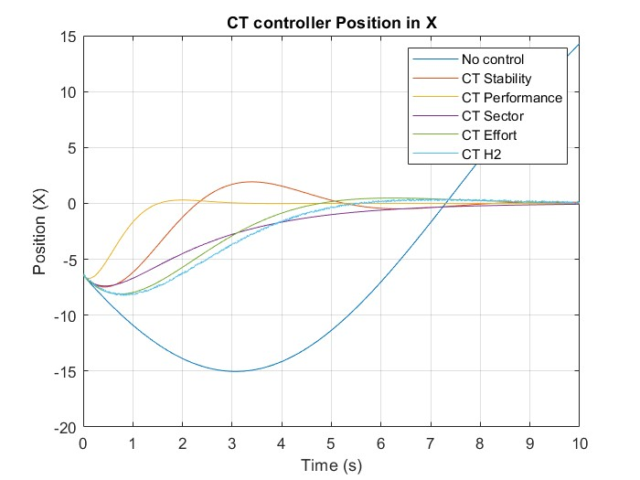
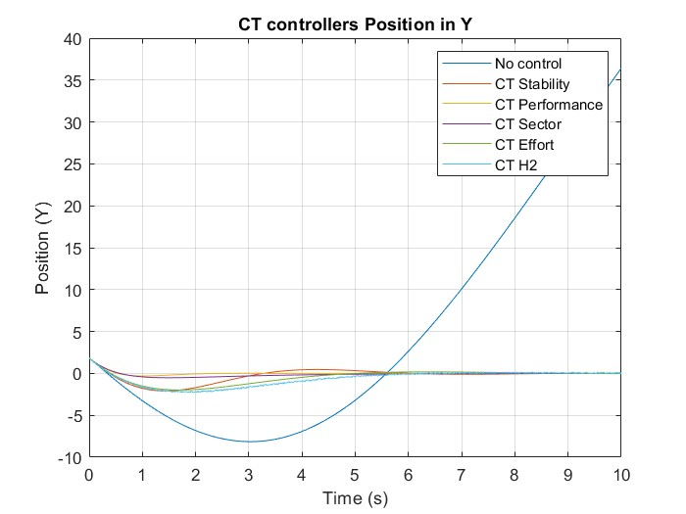
Network Control: Project 22
Continuous time – Position of mass 1 with decentralized structure

Slide 17
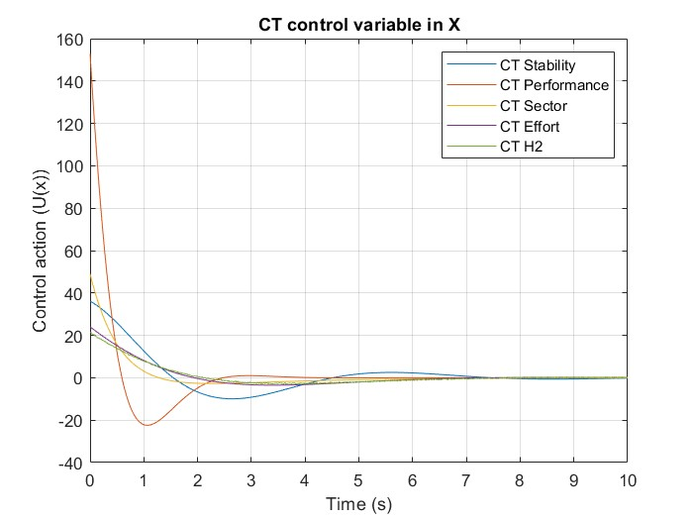
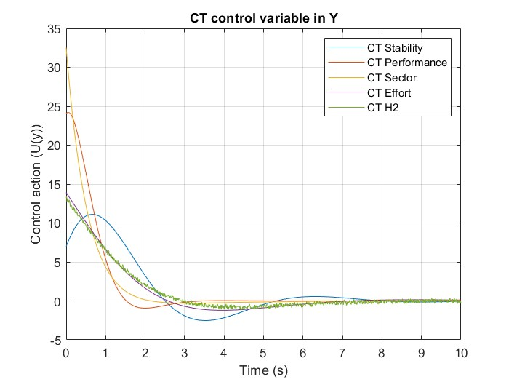
Network Control: Project 22
Continuous time – Decentralized control variables

Slide 18


Network Control: Project 22
Continuous time – Distrubuited star stability and performance control

Slide 19

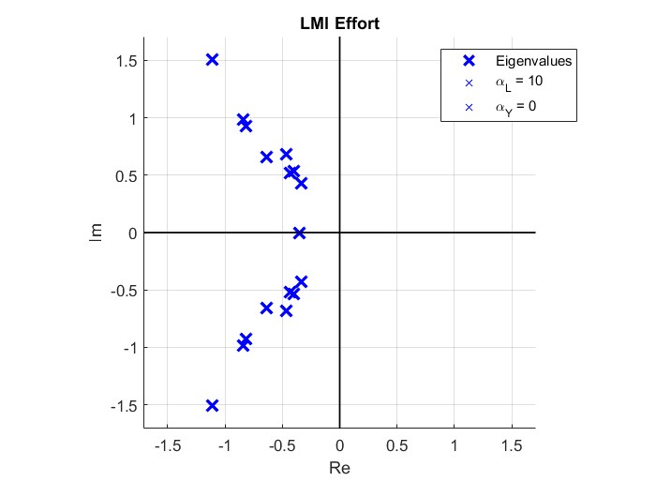
Network Control: Project 22
Continuous time – Distrubuited star sector and effort control

Slide 20
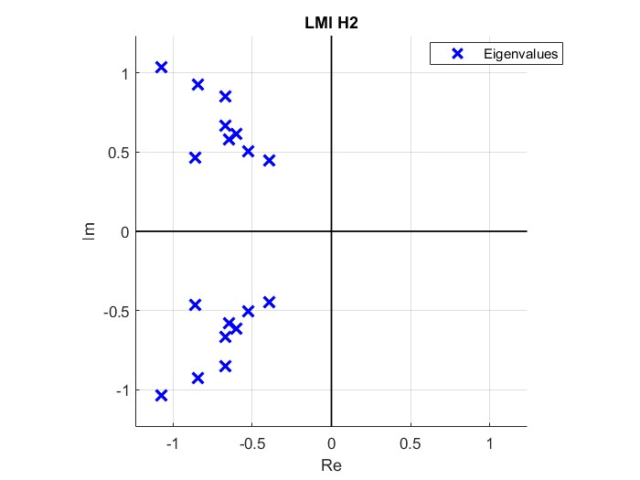
Network Control: Project 22
Continuos time – Distribuited star H2 control

Slide 21
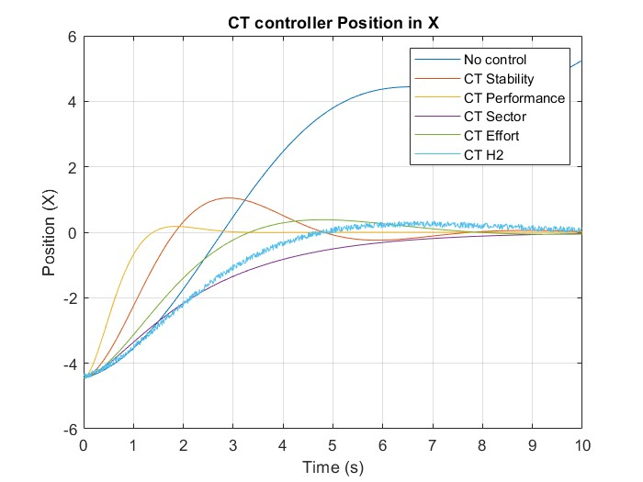
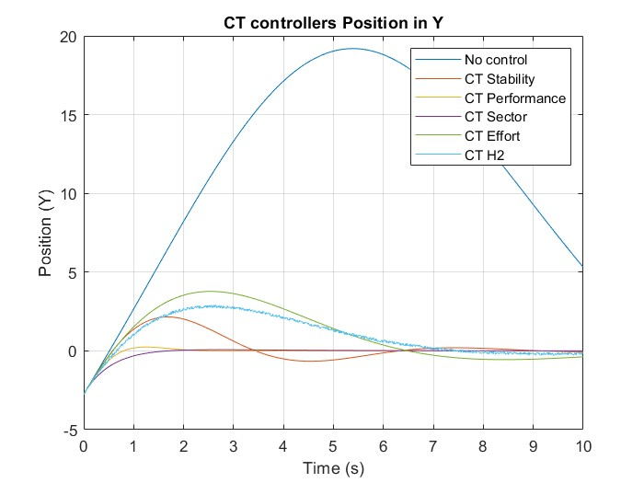
Network Control: Project 22
Continuous time – Position of mass 1 with distribuited star structure
l

Slide 22
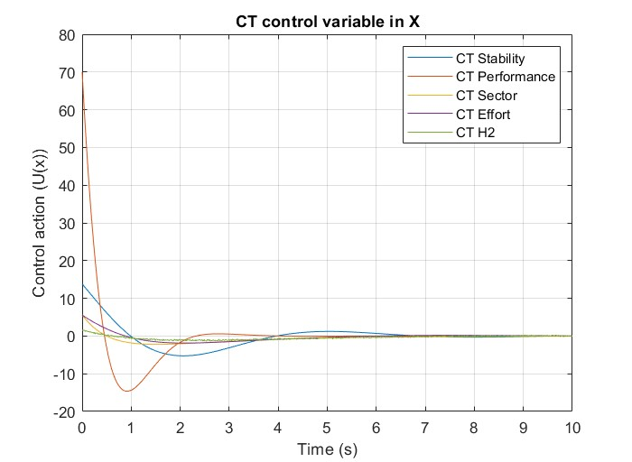
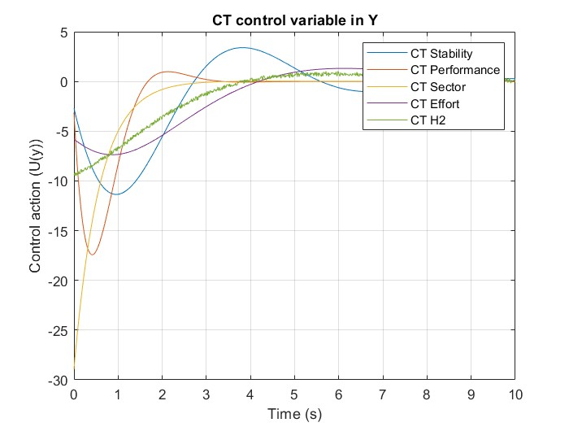
Network Control: Project 22
Continuous time – Distribuited star control variables
l

Slide 23
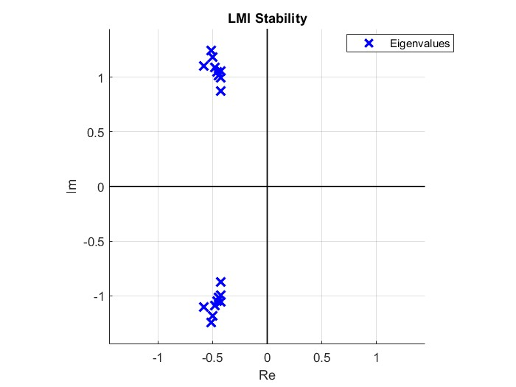
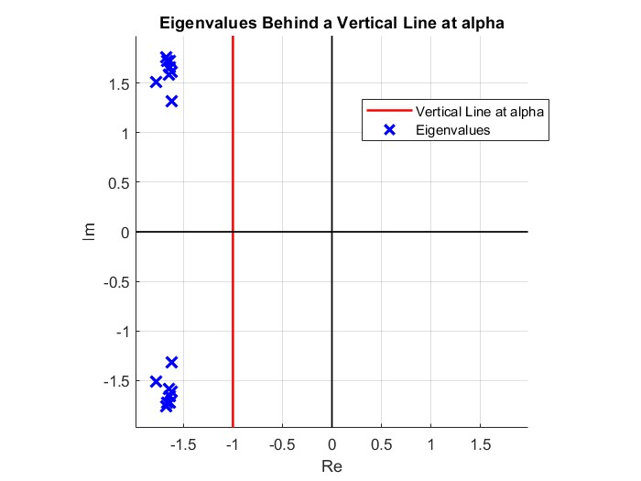
Network Control: Project 22
Continuous time – Distrubuited string stability and performance control

Slide 24
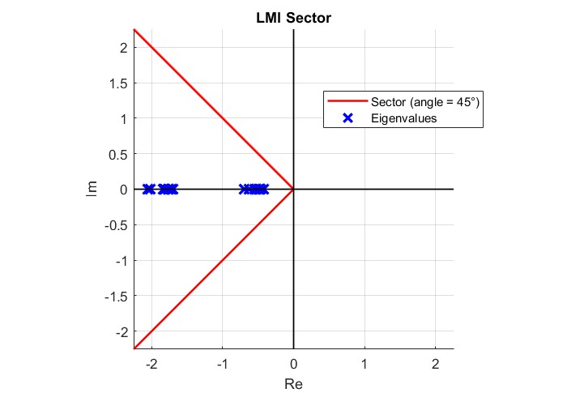
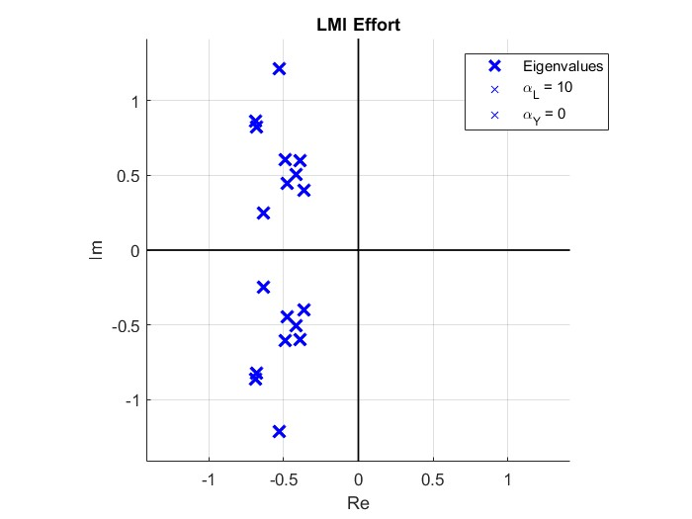
Network Control: Project 22
Continuous time – Distrubuited string sector and effort control

Slide 25
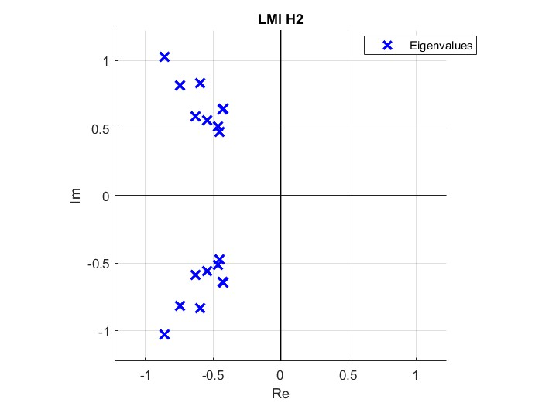
Network Control: Project 22
Continuous time – Distrubuited string H2 control

Slide 26
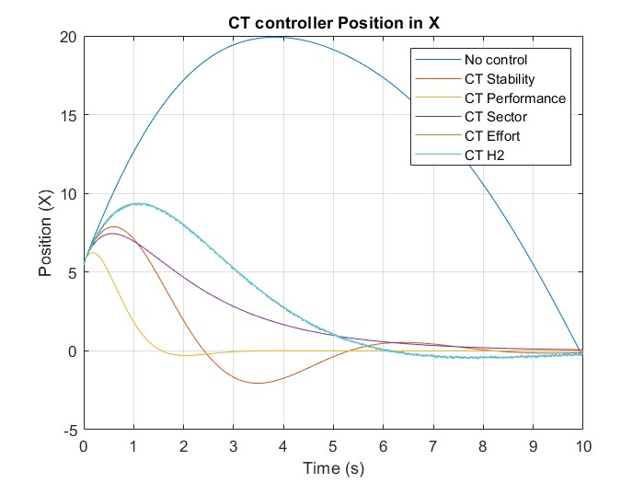
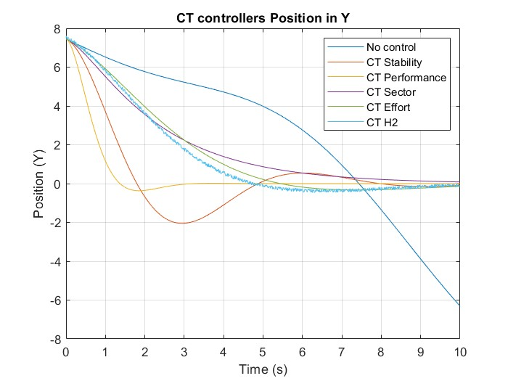
Network Control: Project 22
Continuous time – Position of mass 1 with distribuited string structure

Slide 27
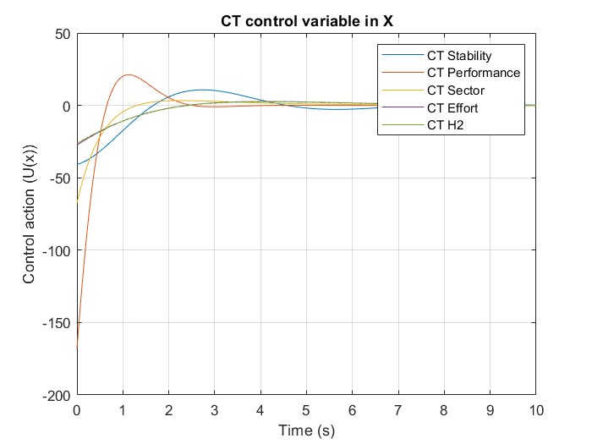
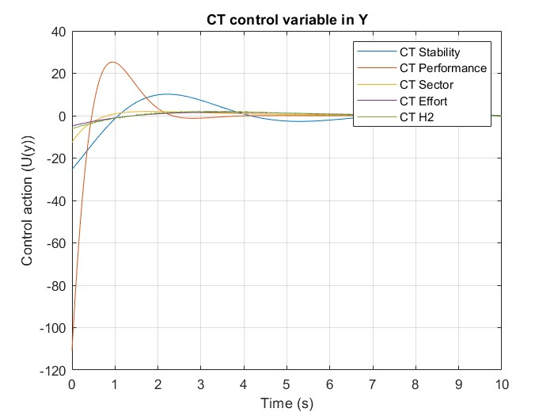
Network Control: Project 22
Continuous time – Distribuited string control variables

Slide 28
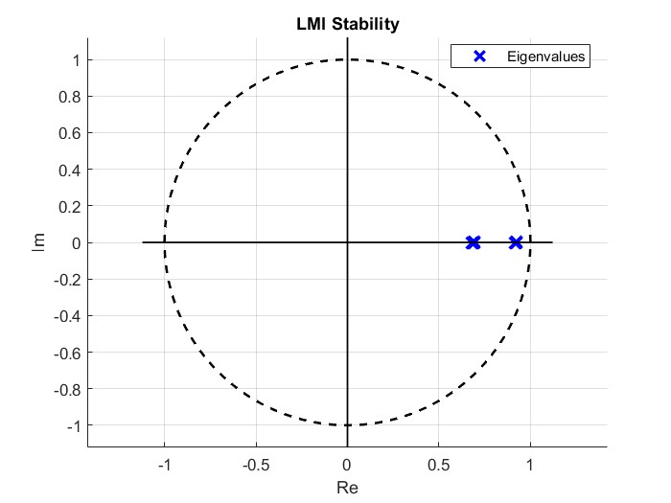
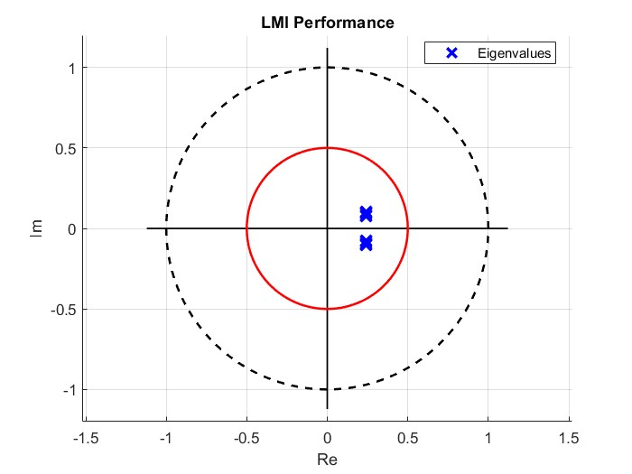
Network Control: Project 22
Discrete Time - Cetralized stability and performance control

Slide 29
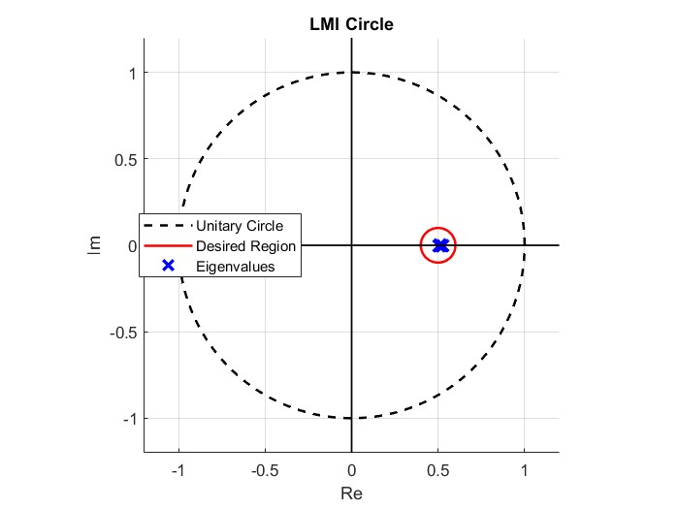
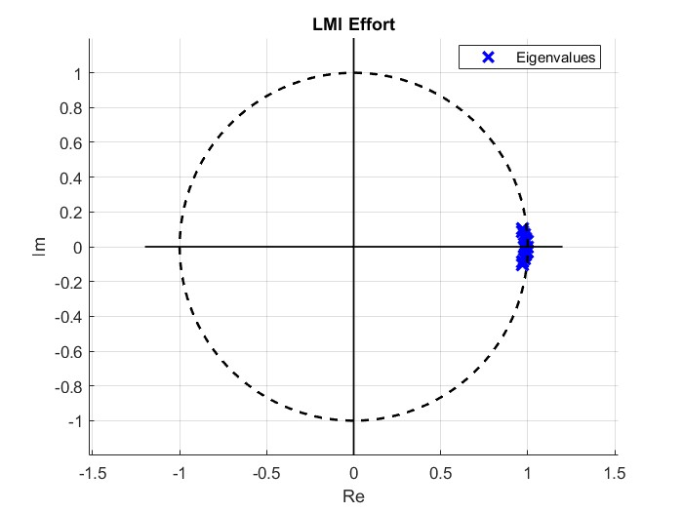
Network Control: Project 22
Discrete time – Centralized circle and effort control

Slide 30
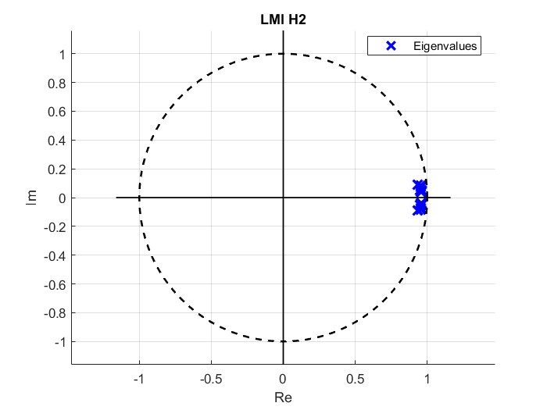
Network Control: Project 22
Discrete time – Centralized H2 control

Slide 31


Network Control: Project 22
Discrete time –Position of mass 1 with centralized structure

Slide 32


Network Control: Project 22
Discrete time – Centralized control variables

Slide 33


Network Control: Project 22
Descrete Time - Decetralized stability and performance control

Slide 34


Network Control: Project 22
Descrete Time - Decetralized circle and effort control

Slide 35

Network Control: Project 22
Discrete time – Decentralized H2 control

Slide 36


Network Control: Project 22
Discrete time –Position of mass 1 with decentralized structure

Slide 37




Network Control: Project 22
Discrete time – Decentralized control variables

Slide 38


Network Control: Project 22
Descrete Time – Distribuited star stability and performance control

Slide 39


Network Control: Project 22
Descrete Time – Distribuited star circle and effort control

Slide 40

Network Control: Project 22
Discrete time – Distrubuited star H2 control

Slide 41


Network Control: Project 22
Discrete time –Position of mass 1 with distribuited star structure

Slide 42




Network Control: Project 22
Discrete time – Distribuited star control variables

Slide 43


Network Control: Project 22
Descrete Time – Distribuited string stability and performance control

Slide 44


Network Control: Project 22
Descrete Time – Distribuited string circle and effort control

Slide 45

Network Control: Project 22
Discrete time – Distribuited string H2 control

Slide 46


Network Control: Project 22
Discrete time –Position of mass 1 with distribuited string structure

Slide 47


Network Control: Project 22
Discrete time – Distribuited string control variables

